Slide 1
Sales Force Operations &
Decision Support:
Promotion Mix and Targeting Group
Promotion Mix Process Overview
January 2005

Slide 2
Goals of Promotion Mix Analysis
Measure Rx and $ response of customers to marketing and sales interventions
Recommend optimal level and optimal mix of marketing and sales interventions by customer type, by brand, and across brands
Provide context for decision-makers by showing how competitors are allocating their sales and marketing resources

Slide 3
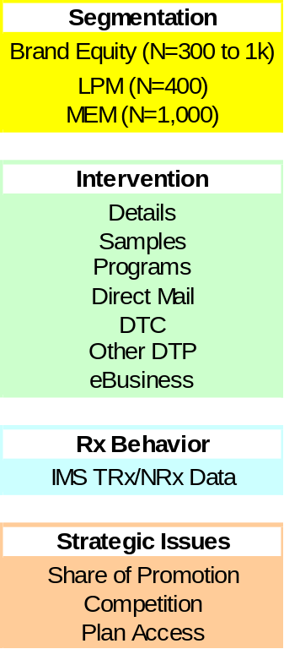
Promotion Mix Process
What is the right level of interventions and their mix?
Promotion Mix Optimization
Within Brand & Across Brand Tradeoffs
What is the
optimal call plan?
Targeting & Local Market Optimization
Implementation & Measurement

Slide 4
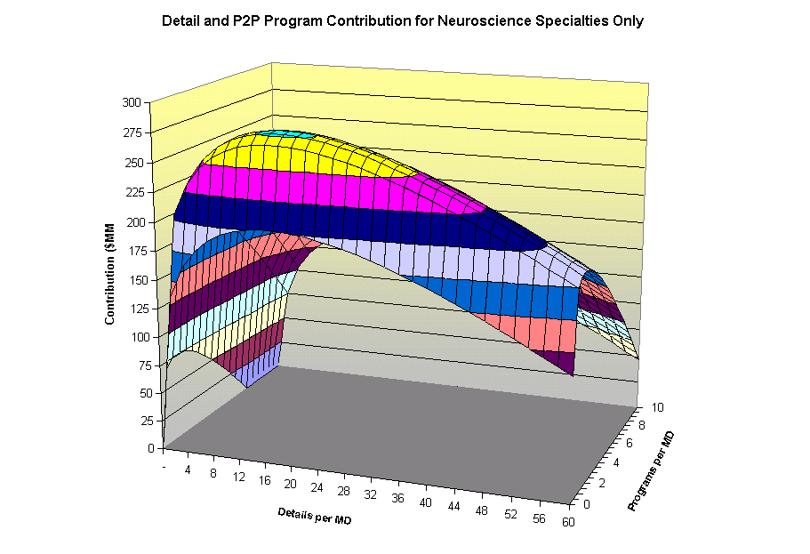
Promotion Mix Analytical Process
Hierarchical Response Models
Widely used in the Consumer Packaged Goods, Travel, Finance, and Pharma industries
They greatly increase the reliability of estimates by tempering information for an individual customer with data from many customers over time
Optimization
Non-Linear Programming is our primary tool -a classic technique for optimization
Artificial Intelligence methods are used to handle more complex problems, such as cross-brand tradeoffs
The idea is to recommend the optimal solution, not simply the first acceptable one

Slide 5
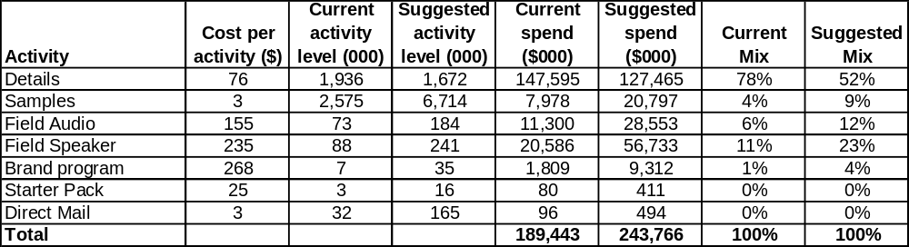
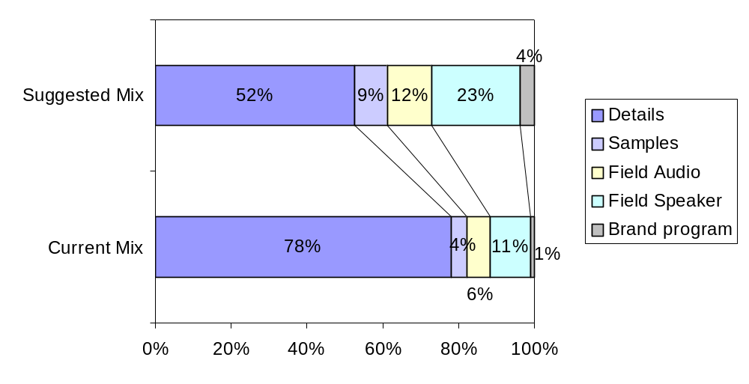
Preliminary mix results**
Preliminary mix results suggest
Decreasing the mix of details
Increasing the mix of samples and programs
Illustration
** Subject to change if the forecasts are revised
Note:
Promotional spend based on detailing, sampling, programs, mail and starter pack to the 118,122 MDs used for analysis and the cost assumptions per activity
Direct Mail and Starter pack not shown since the % mix is less than 1%
Imposed a constraint of min 30% spend to adult targets and a 3 times maximum deviation in mix for brand programs, starter pack and direct mail

Slide 6
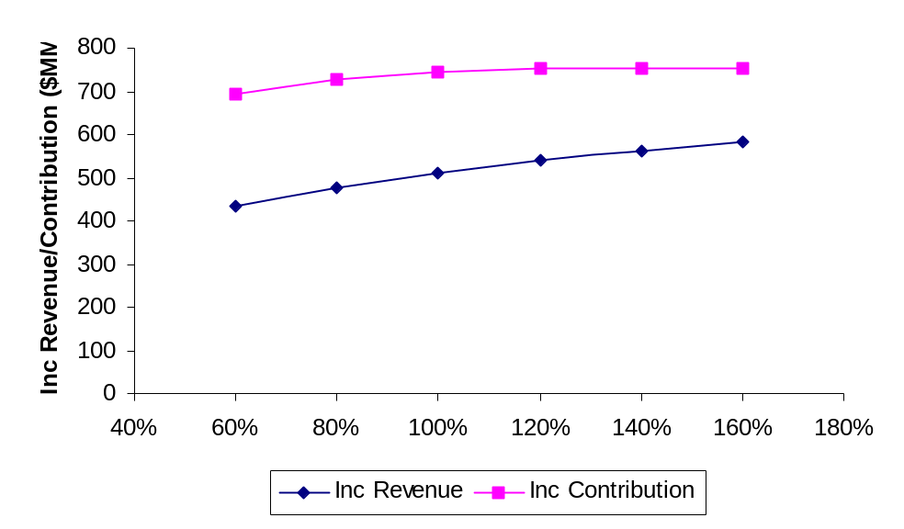
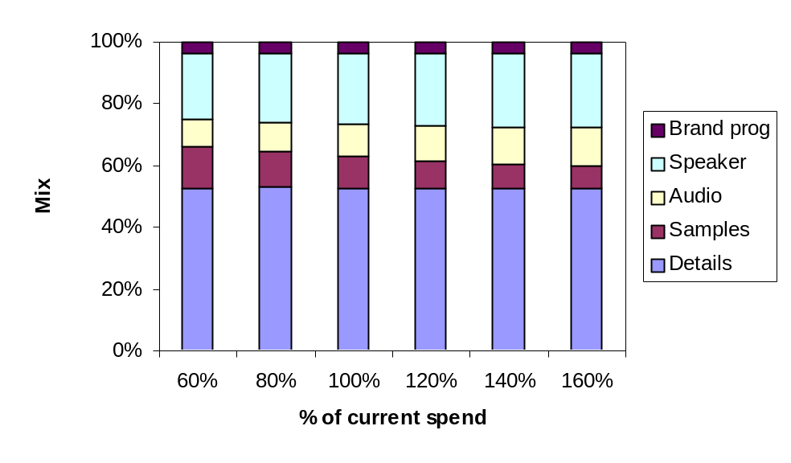
Sensitivity to spend
Contribution curve is flat around current spend levels
  Gives flexibility in terms of choosing spend levels based on knowledge of other factors that a model may not be able to capture
As spend increases, the mix of samples decreases where the mix of programs increases
Illustration

Slide 7
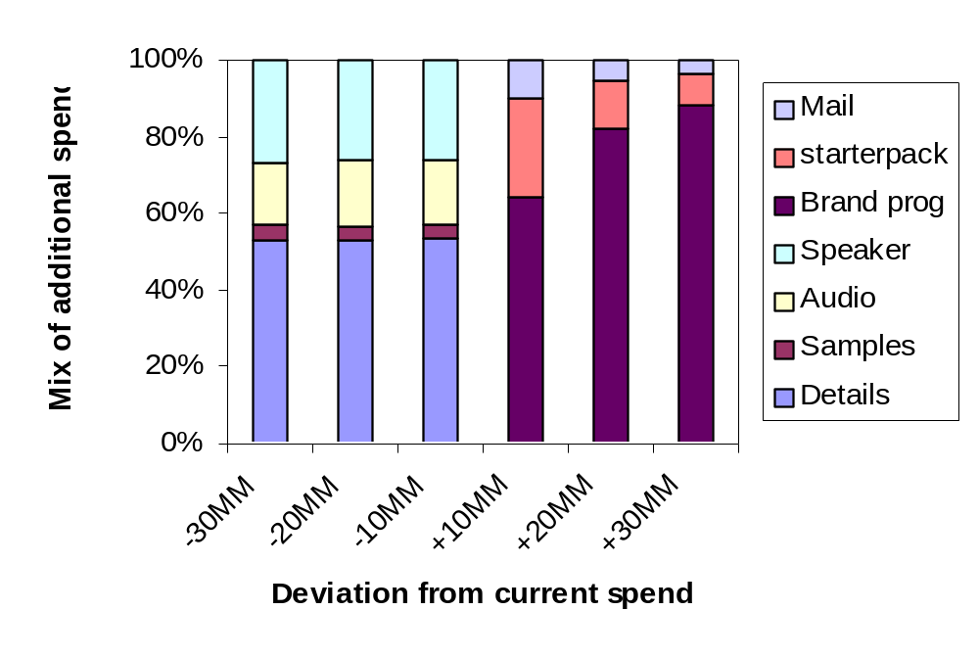
Incremental spend allocation
Illustration
Increase in spend is allocated to brand programs and other DTP
Decrease in spend is achieved by reducing sales force effort

Slide 8
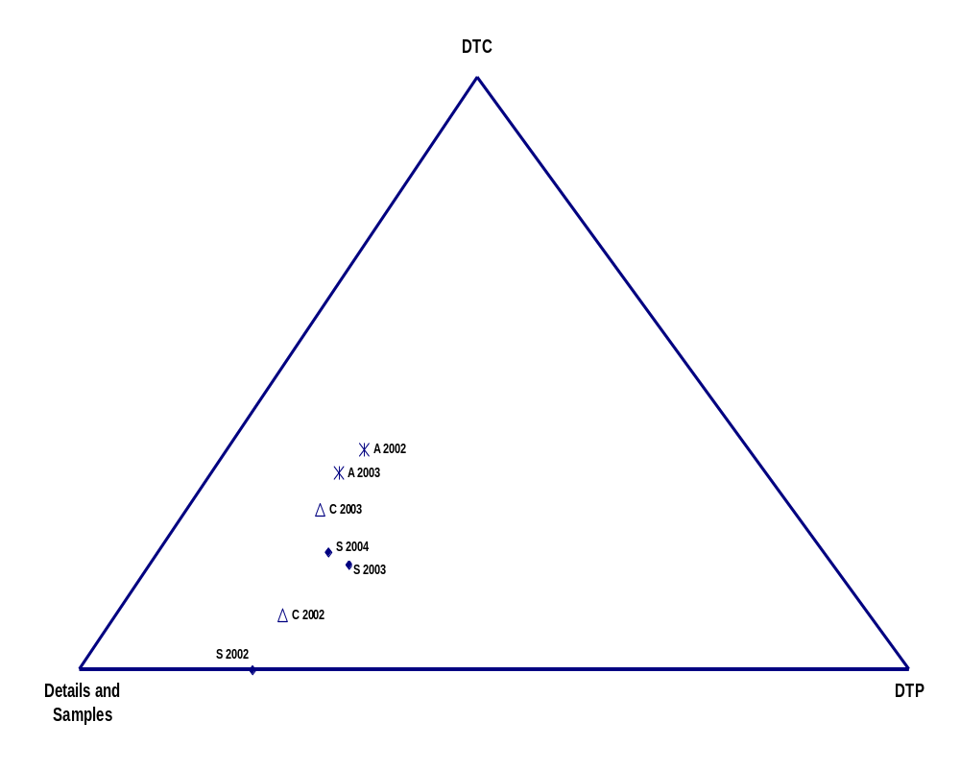
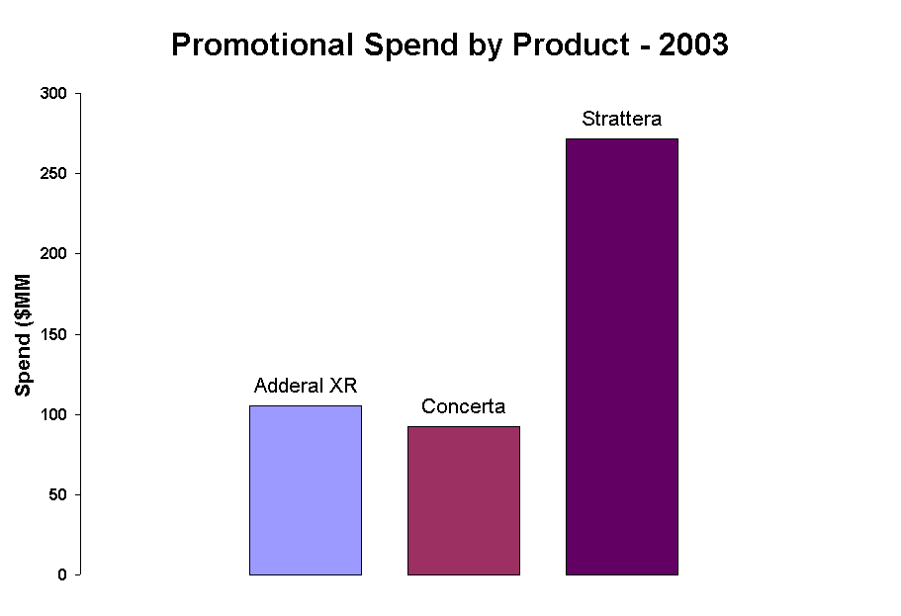
Strattera Comparison with History and Competitors
Illustration
Concerta and Adderall XR had a higher proportion of DTC in their Mix in 2003
Source:IMS Audit data

